Slide 1
CMOS Inverter
ECE4140/6240
Fall 19
Professor M. E. Zaghloul
Class 5
M.E.Zaghloul

Slide 2
Today Lecture
DC characteristics of CMOS inverter
Dynamic characteristics of CMOS inverter
Power ,Energy, and Energy Delay
Chapter 5 of the text
M.E.Zaghloul

Slide 3
The CMOS Inverter: A First Glance
V
DD
V
V
in
out
C
L
M.E.Zaghloul

Slide 4
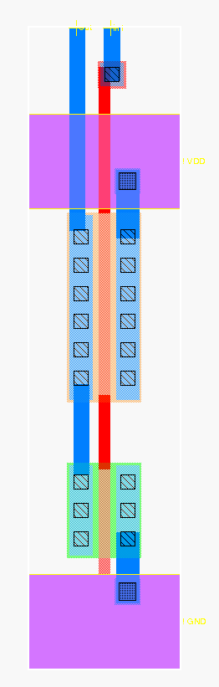
CMOS Inverter max Layout
Out
In
metal1-poly via
metal1
polysilicon
metal2
V_{DD}
pdiff
PMOS (4/.5 = 8/1)
NMOS (2/.5 = 4/1)
metal1-diff via
ndiff
GND
metal2-metal1 via
M.E.Zaghloul

Slide 5
Relative Transistor Sizing
When designing static CMOS circuits, balance the driving strengths of the transistors by making the PMOS section wider than the NMOS section to
  maximize the noise margins and
  obtain symmetrical characteristics
M.E.Zaghloul

Slide 6
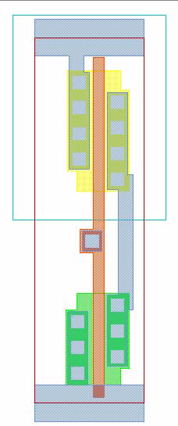

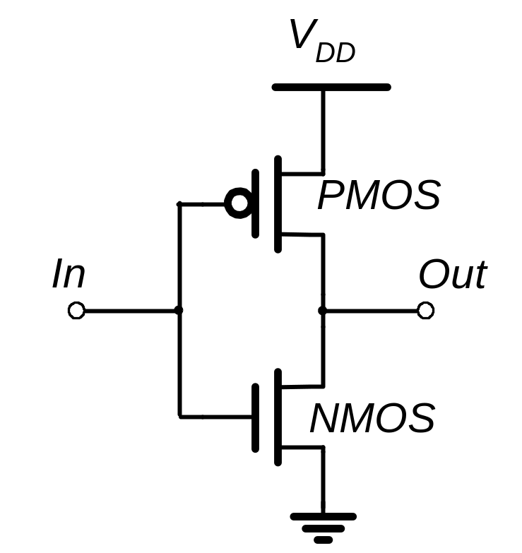
CMOS Inverter
N Well
V
DD
PMOS
2λ
Contacts
In
Out
Metal 1
Polysilicon
NMOS
GND
M.E.Zaghloul

Slide 7
Static Characteristics of Inverter
-Transfer Characteristics
-Noise margins
M.E.Zaghloul

Slide 8
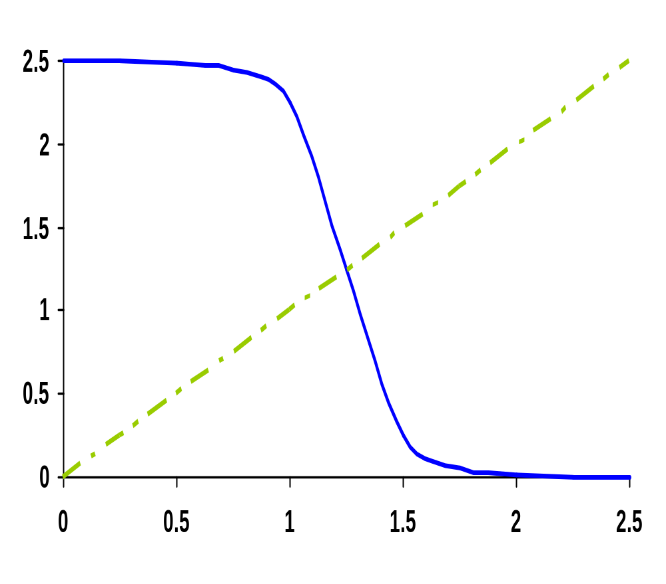
CMOS Inverter VTC
V_{out} (V)
V_{in} (V)
M.E.Zaghloul
Notes:
For class handout – hide for class

Slide 9
CMOS Inverter VTC
NMOS off
PMOS res
NMOS sat
PMOS res
NMOS sat
PMOS sat
V_{out} (V)
NMOS res
PMOS sat
NMOS res
PMOS off
V_{in} (V)
M.E.Zaghloul
Notes:
For lecture
VTC of the inverter exhibits a very narrow transition zone; high gain during switching transient (when both PMOS and NMOS are simultaneously on and in saturation). In that region, a small change in input voltage results in a large output voltage variation.
Indicate on VTC plot where VTn and VTp lie

Slide 10
Switching Threshold
V_{M} where V_{in} = V_{out} (both PMOS and NMOS are in saturation since V_{DS} = V_{GS}) (page 185 in text)
By equating the current through the transistors
V_{M} = rV_{DD}/(1 + r) where r = k_{p}V_{DSATp}/k_{n}V_{DSATn}
This equation is obtained from equating ID in PMOS and NMOS
Switching threshold set by the ratio r, which compares the relative driving strengths of the PMOS and NMOS transistors
Want V_{M} = V_{DD}/2 (to have comparable high and low noise margins), so we want r = 1
M.E.Zaghloul
Notes:
Assumes: The supply voltage is high enough so that the devices are velocity-saturated (VDSAT < VM – VT) and ignores channel length modulation.
Reminder:
k = k’W/L and k’ = mu Cox (mu is carrier mobility)
Larger r to move VM upwards means making the PMOS wider
Smaller r to move VM downwards means making the NMOS wider

Slide 11
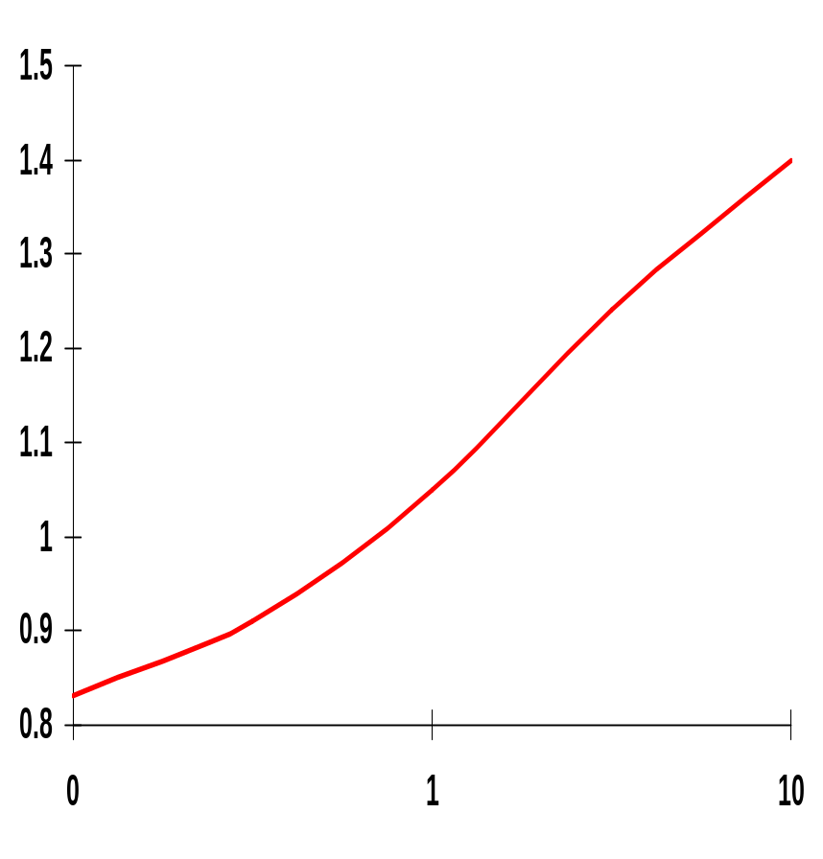
Simulated Inverter V_{M}
V_{M} is relatively insensitive to variations in device ratio
  setting the ratio to 3, 2.5 and 2 gives V_{M}’s of 1.22V, 1.18V, and 1.13V
Increasing the width of the PMOS moves V_{M} towards V_{DD}
Increasing the width of the NMOS moves V_{M} toward GND
V_{M} (V)
.1
~3.4
(W/L)_{p}/(W/L)_{n}
Note: x-axis is semilog
M.E.Zaghloul
Notes:
Plot needs work – but it’s the best I could do with power point graphing
Small variations in ratio don’t make a lot of difference
To move the VM to 1.5V requires a ratio of 11 !!!
Note that the x axis is semilog

Slide 12
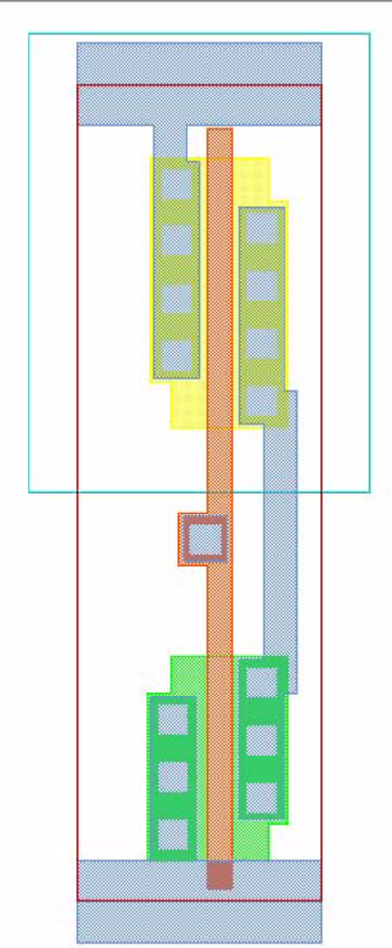
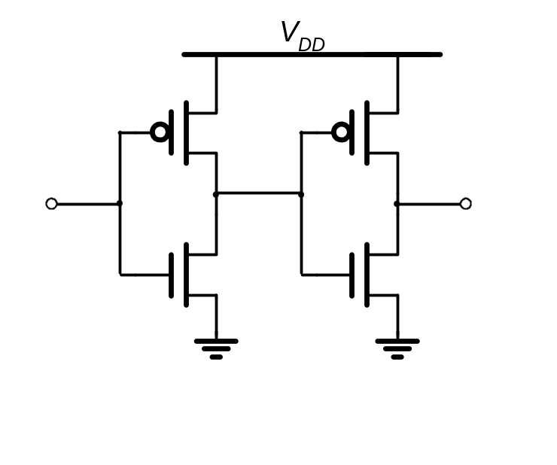
Two Inverters
Share power and ground
Abut cells
Connect in Metal
M.E.Zaghloul

Slide 13
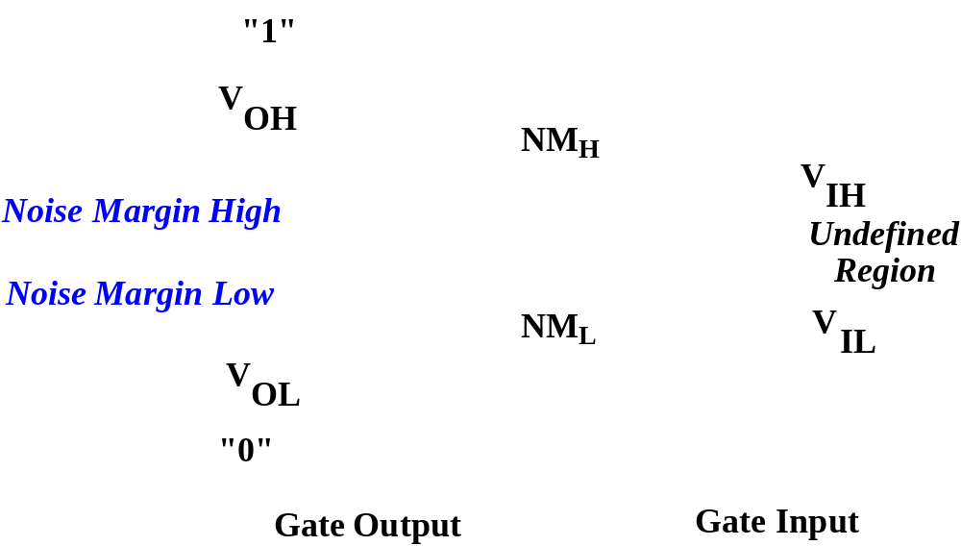
Definition of Noise Margins
M.E.Zaghloul

Slide 14
Scaling Supply Voltage
Reducing VDD will reduce power and will affect delay
VTC is sensitive to supply voltage , as VDD decreases, it increases the gain up to a limit
Small VDD will reduce the signal and reduce internal noise, but design is more sensitive to external noise
M.E.Zaghloul

Slide 15
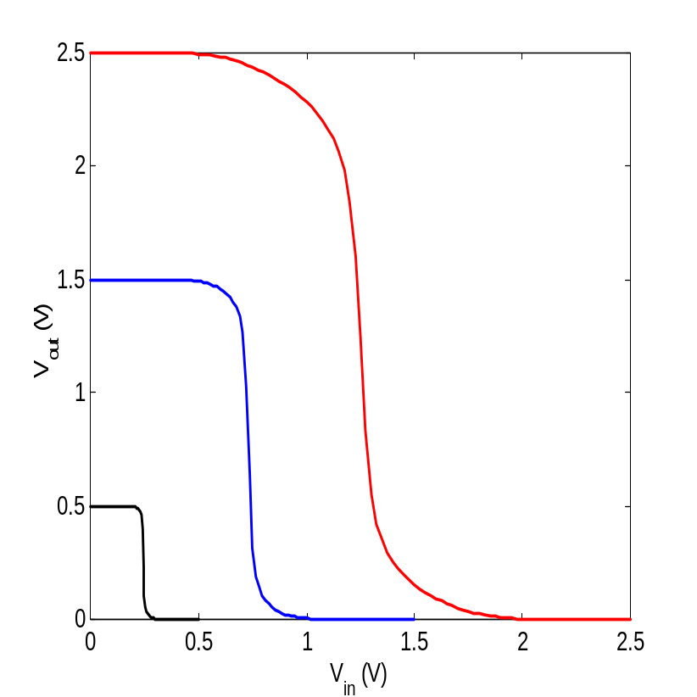
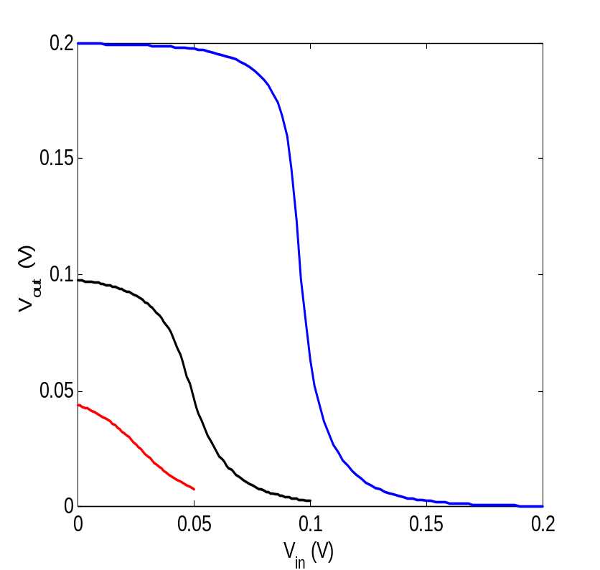
Scaling the Supply Voltage
Gain=-1
Reducing voltage improves gain
It is worse for very low power supply

Slide 16
Inverter Dynamic Behavior
-Time Delay of inverter
-Time delay of chain of inverters
M.E.Zaghloul

Slide 17
CMOS Inverter:
Switch Model of Dynamic Behavior
V_{DD}
V_{DD}
R_{p}
V_{out}
V_{out}
C_{L}
C_{L}
R_{n}
V_{in} = 0
V_{in} = V _{DD}
Gate response time is determined by the time to charge C_{L} through R_{p} (discharge C_{L} through R_{n})
M.E.Zaghloul
Notes:
For class.
response determined mainly by the output capacitance of the gate, CL - drain diffusion capacitance of the NMOS and PMOS transistors; the connecting wires, and the input capacitances of the fan-out gates
A fast gate is built either by keeping the output capacitance small or by decreasing the on-resistance or the transistor (or both)
Decreasing the on-resistance achieved by increasing the W/L ratio of the device
Be aware that the on-resistance of the NMOS and PMOS transistors is not constant; rather it is a nonlinear function of the voltage across the transistor

Slide 18
Capacitances and Transistors
response determined mainly by the output capacitance of the gate, CL - drain diffusion capacitance of the NMOS and PMOS transistors; the connecting wires, and the input capacitances of the fan-out gates
A fast gate is built either by keeping the output capacitance small or by decreasing the on-resistance or the transistor (or both)
Decreasing the on-resistance achieved by increasing the W/L ratio of the device
M.E.Zaghloul

Slide 19
Resistances and capacitances
Notice that the on-resistance of the NMOS and PMOS transistors is not constant; rather it is a nonlinear function of the voltage across the transistor
M.E.Zaghloul

Slide 20
Computing the capacitances
Last class we computed the gate capacitance
Diffusion capacitances
Wiring capacitances
Gate Capacitance of Fan-Out
M.E.Zaghloul

Slide 21
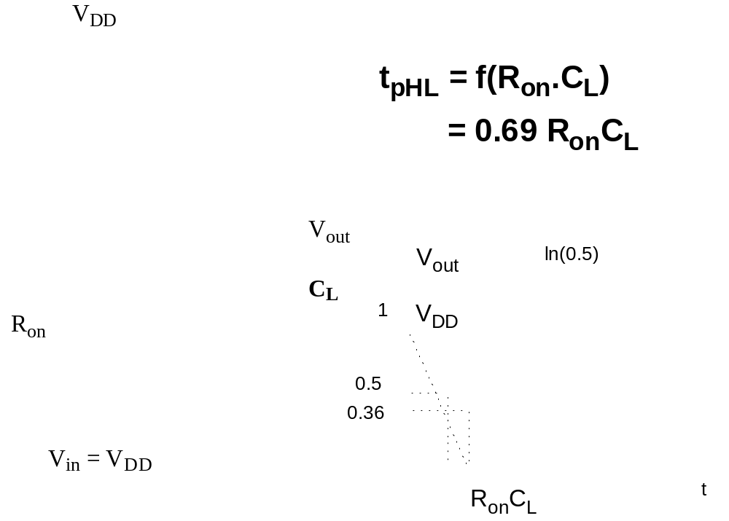
CMOS Inverter Propagation Delay
Analysis of first order linear RC, page 152 in text
0.69 =ln 2
Reqn equivalent resistance
M.E.Zaghloul

Slide 22
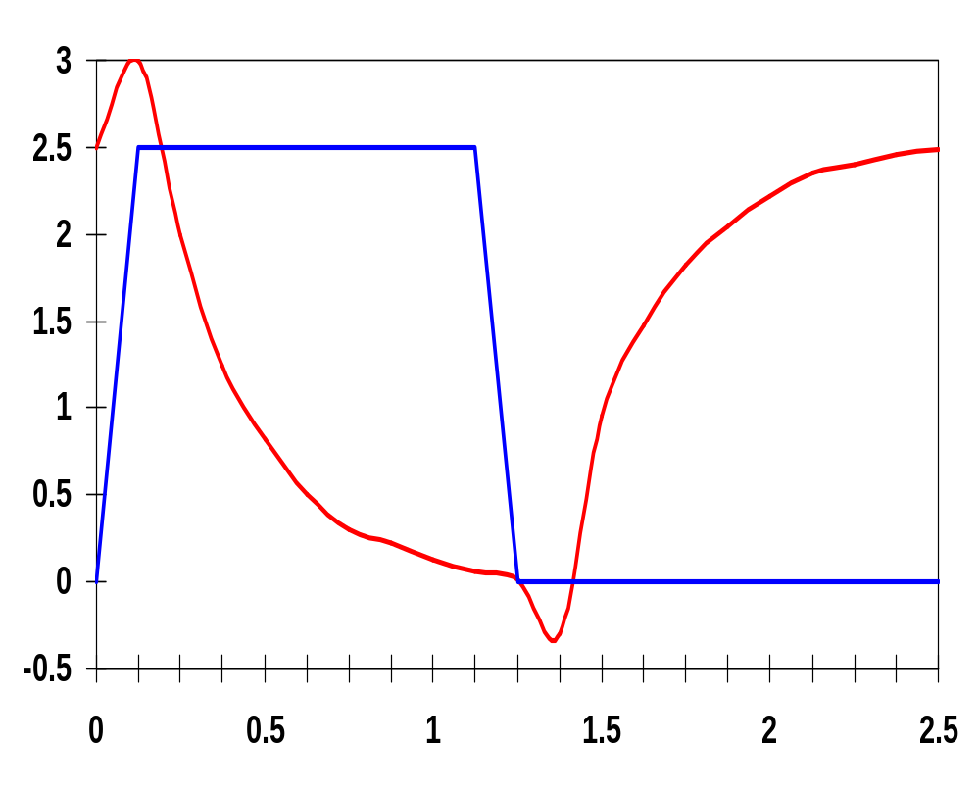
Inverter Transient Response
V_{DD}=2.5V
0.25μm
W/L_{n} = 1.5
W/L_{p} = 4.5
R_{eqn}= 13 kΩ (W-to-L is 1.5)
R_{eqp}= 31 kΩ (W-to-
L is 4.5)
V_{in}
V_{out} (V)
t_{f}
t_{r}
t_{pHL}
t_{pLH}
t_{pHL} = 36 psec
t_{pLH} = 29 psec
so
t_{p} = 32.5 psec = Average of the above
x 10⁻¹⁰
t (sec)
From simulation: t_{pHL} = 39.9 psec and t_{pLH} = 31.7 psec
M.E.Zaghloul
Notes:
For lecture
Reqn = 8.67 and Reqp = 6.89
The top time is from simulation
the bottom from solving the (simplified) equations
Note overshoots on simulated output signals. Caused by the gate-drain capacitances of the inverter transistors which couple the steep voltage step at the input node directly to the output before the transistors can even start to react to the changes at the inputs.
These overshoots have a negative effect on gate performance and explain why the simulated delays are larger than the estimations.

Slide 23
Simulation versus Calculations
Note overshoots on simulated output signals. Caused by the gate-drain capacitances of the inverter transistors which couple the steep voltage step at the input node directly to the output before the transistors can even start to react to the changes at the inputs.
These overshoots have a negative effect on gate performance and explain why the simulated delays are larger than the estimations
M.E.Zaghloul

Slide 24
Inverter Delay
The equivalent resistance of the “ON” device is nonlinear function of voltage ( Reqn or Reqp).
Propagation delay is 50% point occurs at 0.69R_{equ}C_{L}
C_{L} depends on the next gate it is the sum of the gate capacitance, and the wire capacitance
M.E.Zaghloul

Slide 25
Design for Performance
Keep all capacitances small
Increase transistor sizes
  Resistance is inversely proportion to size
Increase V_{DD} (????)
M.E.Zaghloul

Slide 26
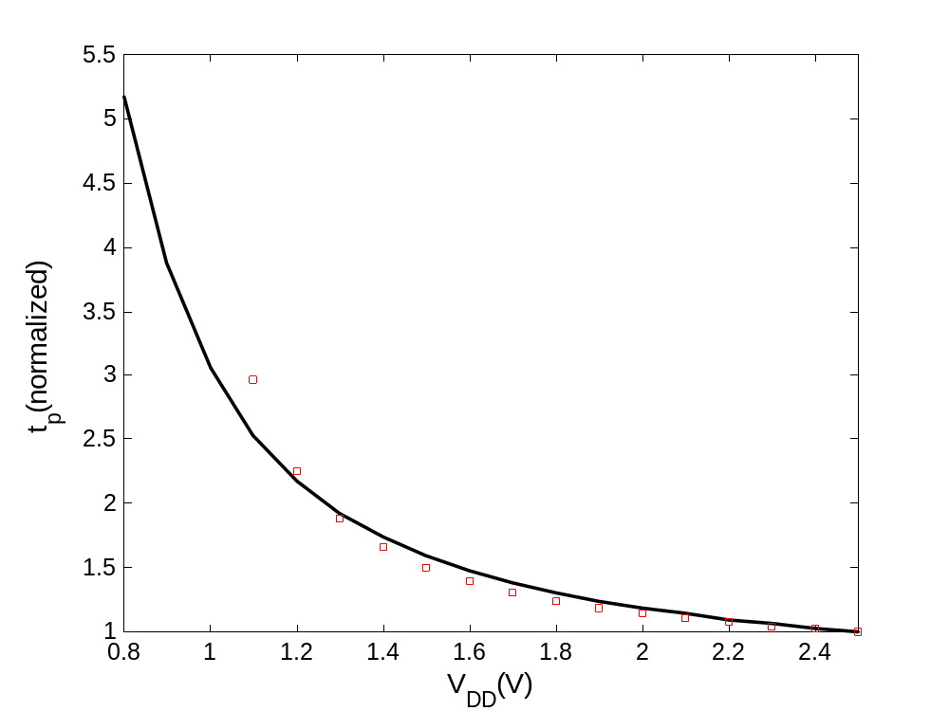
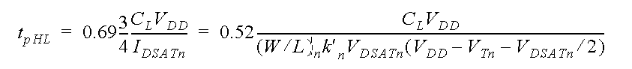
Delay of CMOS Inverter as a function of V_{DD}
M.E.Zaghloul

Slide 27
Design for Performance notes
Reduce C_{L}
  internal diffusion capacitance of the gate itself
    keep the drain diffusion as small as possible ( good design)
  interconnect capacitance
  fan out capacitance, wiring fanout
Increase W/L ratio of the transistor
  the most powerful and effective performance optimization tool in the hands of the designer
  watch out for self-loading! – when the intrinsic capacitance dominates the extrinsic load
Increase V_{DD}
  can trade-off energy for performance
  increasing V_{DD} above a certain level yields only very minimal improvements
  reliability concerns enforce a firm upper bound on V_{DD}
M.E.Zaghloul
Notes:
Good design practice keeps drain diffusion areas as small as possible
Self-loading is when the intrinsic capacitance (diffusion capacitance) starts to dominate the extrinsic load formed by wiring and fan-out.
Increasing VDD also has reliability concerns - oxide breakdown, hot-electron effects - that enforce firm upper bounds on the supply voltage in deep submicron processes.

Slide 28
Ratio of PMOS to NMOS
Optimum transistors ratio can be derived to optimize the delay if symmetry and reduced noise margin are not of prime concerns
Two inverters gates are cascaded , the approximate load capacitance of the first gate is
C_{L} =( Cdp1+ Cdn1) + (Cgp2 + Cgn2) + C_{W}
M.E.Zaghloul

Slide 29
NMOS/PMOS Ratio
So far we have sized the PMOS and NMOS so that the R_{eq}’s match (ratio of 3 to 3.5)
  symmetrical VTC
  equal high-to-low and low-to-high propagation delays
If speed is the only concern, reduce the width of the PMOS device!
  widening the PMOS degrades the t_{pHL} due to larger parasitic capacitance, let
β = (W/L_{p})/(W/L_{n})
r = R_{eqp}/R_{eqn} (resistance ratio of identically-sized PMOS and NMOS)
B_{opt} = √ r when wiring capacitance is neglected
M.E.Zaghloul
Notes:
Smaller PMOS - speed at the cost of symmetry and noise margin
Widening PMOS of course improves tpLH because it improves Req of the PMOS (increases charge current)
If wiring capacitance dominates, larger values of beta should be used. The surprising result is that smaller device sizes (and hence smaller area) yield a faster design at the expense of symmetry and noise margin.

Slide 30
Result of the above analysis
Smaller devices sizes yield faster design at the expense of symmetry and noise margin
The following example shows propagation delay of CMOS inverter as function of PMOS-to-NMOS transistor ratio
M.E.Zaghloul

Slide 31
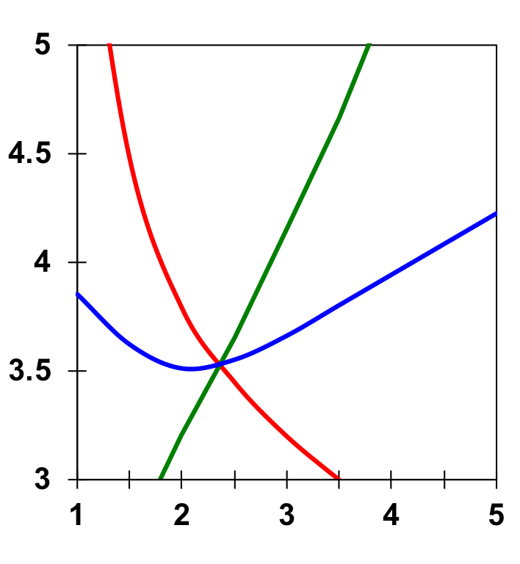
PMOS/NMOS Ratio Effects
x 10⁻¹¹
t_{pLH}
t_{pHL}
β of 2.4 (= 31 kΩ/13 kΩ) gives symmetrical response
β of 1.6 to 1.9 gives optimal performance
t_{p}
t_{p}(sec)
Rise and fall delays are identical at β = 2.4
β = (W/L_{p})/(W/L_{n})
M.E.Zaghloul
Notes:
Observe that the rising and falling delays are identical at the predicted point of beta of 2.4 (the crossing point of the three curves) that is the preferred operation point when the worst-case delay is the prime concern.

Slide 32
Sizing chain of Inverters
Impact of Fan-out on Delay
Load capacitance is composed by Intrinsic and extrinsic capacitance, C_{ext}, is a function of the fan-out of the gate - the larger the fan-out, the larger the external load.
First determine the input loading effect of the inverter. Both C_{g} and C_{int} are proportional to the gate sizing, so C_{int} = ϒC_{g}
_{ϒ} independent of gate sizing ( γ is close to 1 for Submicron), and
t_{p} = 0.69 R_{eq} ( C_{int} + C_{ext} )
t_{p} = t_{p0} (1 + C_{ext}/ ϒC_{g}) = t_{p0} (1 + f/ϒ)
i.e., the delay of an inverter is a function of the ratio between its external load capacitance and its input gate capacitance: the effective fan-out f , f = C_{ext}/C_{g}
M.E.Zaghloul
Notes:
gamma is close to 1 for most submicron processes.

Slide 33
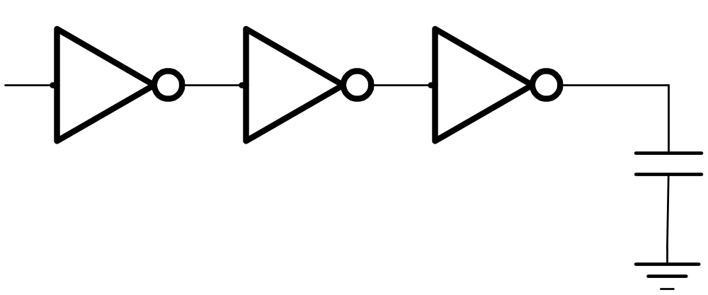
Sizing Inverter Chain
In
Out
C_{L}
If C_{L i} is large load and is given:
How many stages are needed to minimize the delay?
How to size the inverters?
May need some additional constraints.
M.E.Zaghloul

Slide 34
Inverter Chain
Real goal is to minimize the delay through an inverter chain
the delay of the j-th inverter stage is
t_{p,j} = t_{p0} (1 + C_{g,j+1}/(ϒC_{g,j})) = t_{p0}(1 + f_{j}/ ϒ)
and t_{p} = t_{p1} + t_{p2} + . . . + t_{pN}
so t_{p} = SUM t_{p,j} = t_{p0} SUM (1 + C_{g,j+1}/(ϒC_{g,j})) , C_{g,N+1} = C_{L}
In
Out
1
2
N
C_{g,1}
C_{L}
If C_{L} is given
  How should the inverters be sized?
  How many stages are needed to minimize the delay?
M.E.Zaghloul
Notes:
ingores wiring capacitance for now

Slide 35
Sizing chain of Inverters
See Page 208 text
The above equation has N-1 unknown, C_{g,2}, C_{g,3}, … C_{g,N}
THE MINIMUM DELAY CAN BE OBTAINED partial derivative dt_{p}/ dC_{g} =0
The result the optimum size of the inverter is the geometric meanof its neighbers
C_{g,j} _{= √} C_{g,j-1} C_{g,j+1}
M.E.Zaghloul

Slide 36
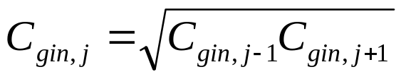
Optimal Tapering for Given N
Delay equation has N - 1 unknowns, C_{gin,2} – C_{gin,N}
Minimize the delay, find N - 1 partial derivatives
Result: C_{gin,j+1}/C_{gin,j} = C_{gin,j}/C_{gin,j-1}
Size of each stage is the geometric mean of two neighbors
each stage has the same effective fan-out (C_{out}/C_{in})
each stage has the same effective fanout and thus the same
delay
M.E.Zaghloul

Slide 37
Sizing the Inverters in the Chain
The optimum size of each inverter is the geometric mean of its neighbors – meaning that if each inverter is sized up by the same factor f wrt the preceding gate, it will have the same effective fan-out and the same delay
f = N√CL/C_{g,1} = N√F
where F represents the overall effective fan-out of the circuit (F = C_{L}/C_{g,1})
and the minimum delay through the inverter chain is
t_{p} = N t_{p0} (1 + ( N√F ) / ϒ)
The relationship between t_{p} and F is linear for one inverter, square root for two, etc.
N
N
M.E.Zaghloul
Notes:
Next question is, “what is the best N to minimize the delay for a given F?”
but first, an example of inverter chain sizing

Slide 38
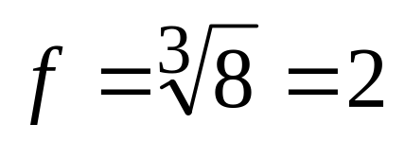
Example
In
Out
1
f
f²
C_{L}= 8 C₁
C₁
C_{L}/C₁ has to be evenly distributed across N = 3 stages:
M.E.Zaghloul

Slide 39
Summary of expression
f = sizing factor = N√ F, where F is overall effective fanout
F = C_{L} / C_{g,1}
The minimum delay through chain is:
t_{p} = N* t_{p0} ( 1+ N√ F/ϒ )
M.E.Zaghloul

Slide 40
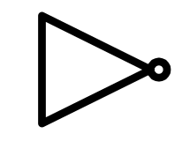
Buffer Design
N f t_{p}
1 64 65
2 8 18
3 4 15
4 2.8 15.3
1
64
1
8
64
1
4
16
64
1
22.6
64
2.8
8
M.E.Zaghloul

Slide 41
Impact of Buffer Staging for Large C_{L}
F (ϒ = 1) | Unbuffered | Two Stage Chain | Opt. Inverter Chain
10 | 11 | 8.3 | 8.3
100 | 101 | 22 | 16.5
1,000 | 1001 | 65 | 24.8
10,000 | 10,001 | 202 | 33.1
Impressive speed-ups with optimized cascaded inverter chain for very large
capacitive loads.
M.E.Zaghloul

Slide 42
Design Challenges
A gate is never designed in isolation: its performance is affected by both the fan-out and the driving strength of the gate(s) feeding its inputs.
Keep signal rise times smaller than or equal to the gate propagation delays.
  good for performance
  good for power consumption
Keeping rise and fall times of the signals small and of approximately equal values is one of the major challenges in high-performance designs - slope engineering.
M.E.Zaghloul
Notes:
tstep is for the zero input slope

Slide 43
Power,Energy, and Energy Delay
M.E.Zaghloul

Slide 44
BREAK
M.E.Zaghloul

Slide 45
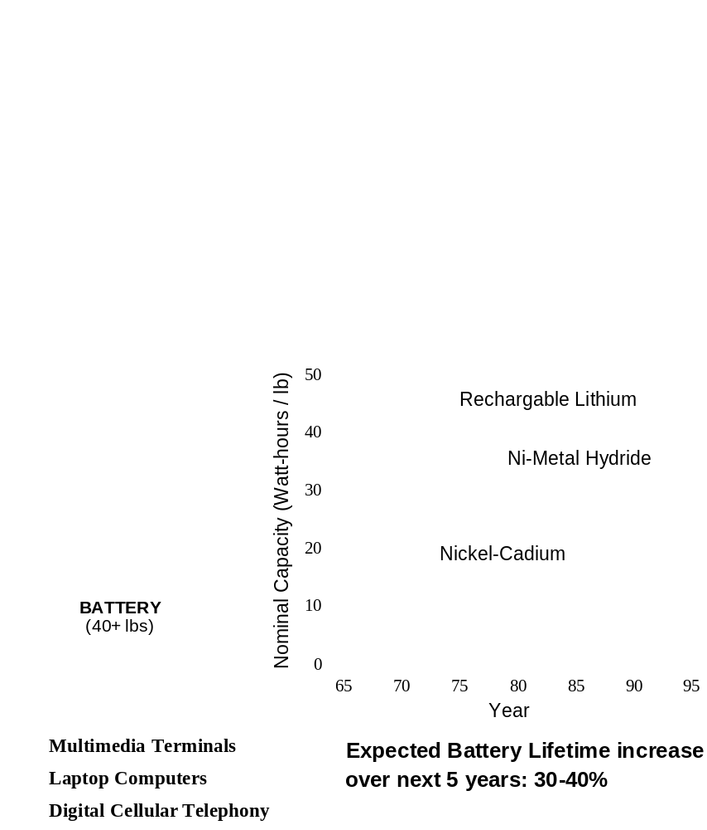
Why worry about power — Portability and HEAT
M.E.Zaghloul

Slide 46
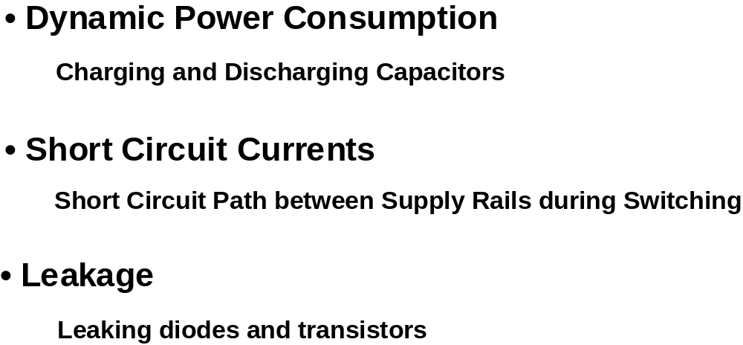
Where Does Power Go in CMOS?
THREE Sources of Power Consumption
M.E.Zaghloul

Slide 47
1. Dynamic Power Dissipation
Vdd
Vin
Vout
C
L
Energy/transition = C
* V
2
L
dd
Power = Energy/transition *
f =
C
* V
2
* f
L
dd
f is the clock frequency
Not a function of transistor sizes!
Need to reduce C
L
, V
dd
, and
f
to reduce power.
M.E.Zaghloul

Slide 48
Dynamic Power Consumption
Every switching cycle Low to High and High to Low takes fixedamount of energy equal to C_{L} (V_{DD})²
In order to compute the power we have to count how often the device switch clock frequency
That is the Dynamic power consumption not related to device size
M.E.Zaghloul

Slide 49
Dynamic Power Dissipation
The power is depending on the clock frequency and the power supply
It also depends on the load capacitor
For design of 1 million gates and assuming the transition occurs at every clock edge, power supply 2.5 volt, then power consumption is 50 W
This is assuming all gates are switching, but in reality the actual activity in the circuit much lower.
M.E.Zaghloul

Slide 50
Dynamic Power Dissipation
Advance technology result in ever higher values of -f
Total capacitance C_{L} increases as more and more gates are placed on a single die
The power consumption per gate is 2.5micro-watt
M.E.Zaghloul

Slide 51
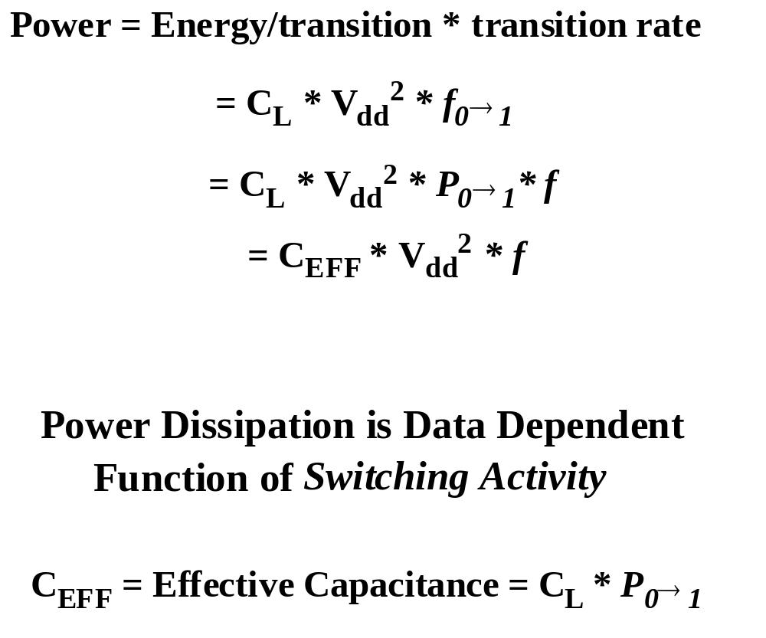
Dynamic Power Consumption - Revisited
P₀₋₁ is the probability that clock event result 0-1 switching
M.E.Zaghloul

Slide 52
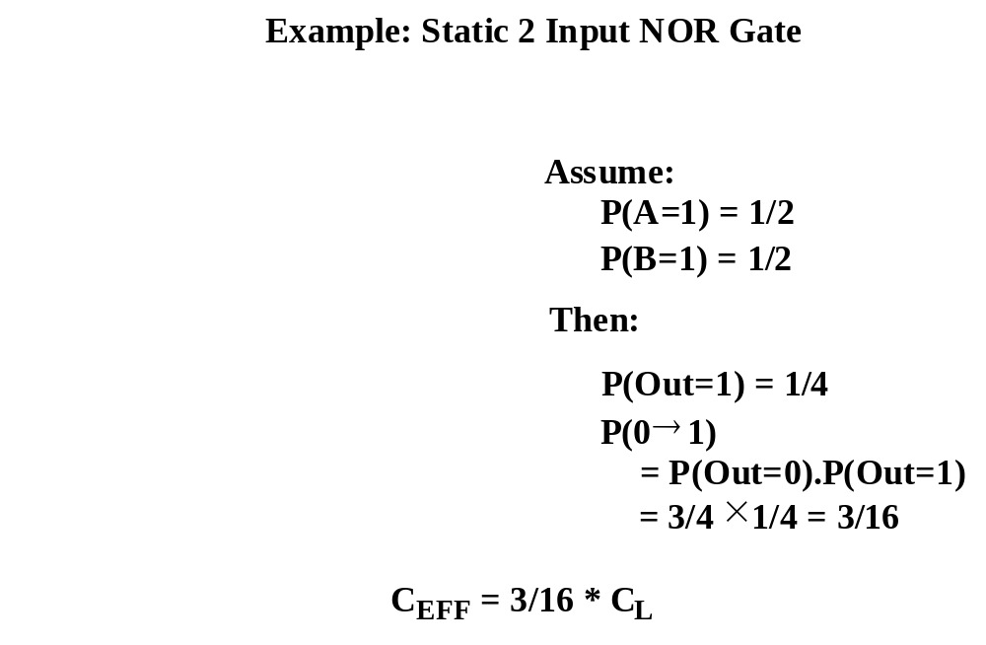
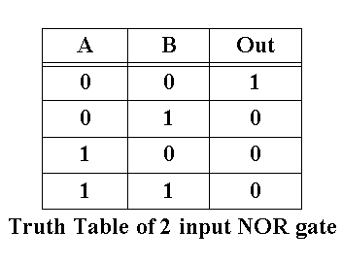
Power Consumption is Data Dependent
M.E.Zaghloul

Slide 53
Principles for Power Reduction
Prime choice: Reduce voltage!
  Recent years have seen an acceleration in supply voltage reduction
  Design at very low voltages still open question (0.6 … 0.9 V ,0.7,..)
Reduce switching activity
Reduce physical capacitance
  Device Sizing is very effective approach
M.E.Zaghloul

Slide 54
2. Short Circuit Power Dissipation
Direct Path Current
The flow of current from VDD to GND during switching, the finite slope of input signal causes direct current path between VDD and GND
Both NMOS and PMOS are conducting simultaneously
Short circuit power energy is
t_{sc}V_{DD}I_{peak}
M.E.Zaghloul

Slide 55
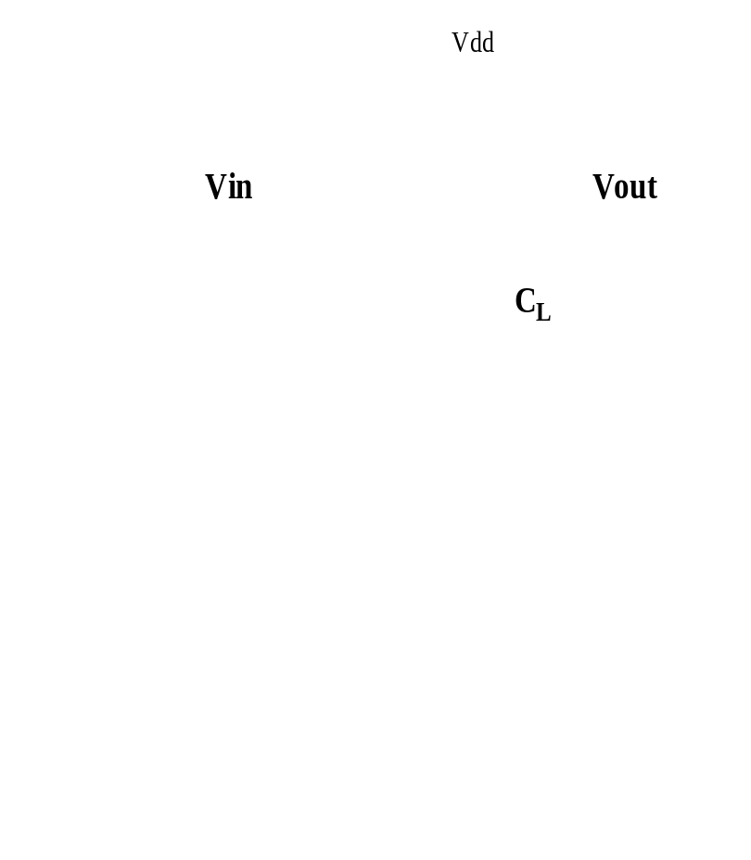
Short Circuit Currents
I_{peak} is determined by the saturation current of the devices
M.E.Zaghloul

Slide 56
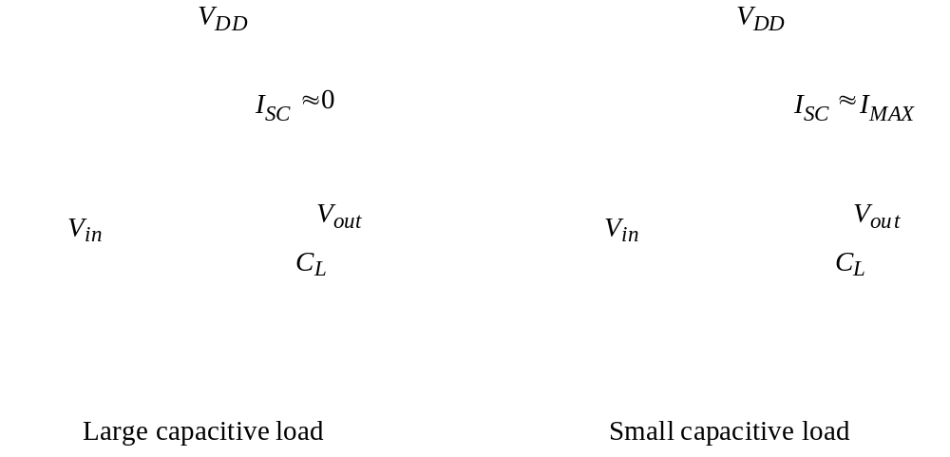
Impact of rise/fall times on short-circuit currents
Worst case if the PMOS is in Sat
M.E.Zaghloul

Slide 57
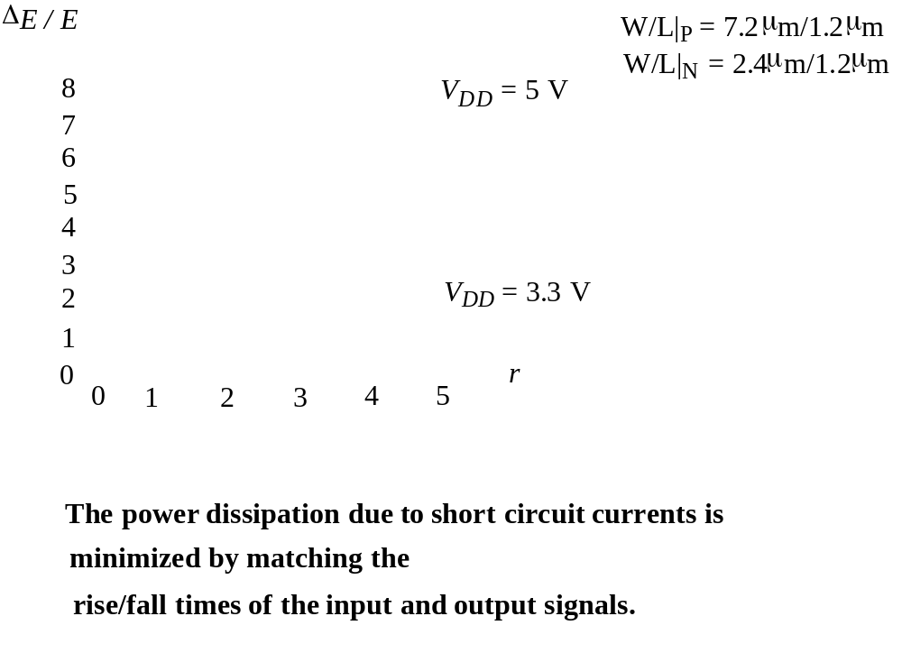
Short-circuit energy as a function of slope ratio
Norm power
Short circuit energy is reduced as VDD is reduced
r is the ratio between input and output rise/fall time
M.E.Zaghloul

Slide 58
Design Techniques
When the load capacitance is too small or the given inverter size, the power is dominated by the short circuit current
When the rise/fall times are equal most power dissipation is associated with dynamic power
When load capacitance is too large power is dissipated in charging and discharging CL
M.E.Zaghloul

Slide 59
3. Static Power Dissipation
Leakage power
Static dissipation due to leakage current in diode
As the PMOS and NMOS are never simultaneously in steady state operation, there is leakage current through the reverse biased diode junction
Leakage is very large as the technology progress.. Most dominant
M.E.Zaghloul

Slide 60
Leakage Current
Ideally it is zero
Leakage current flowing through the reverse bias diode in absence of switching activity
The leakage current is small in range of pico-Amp, its value increases as temp increases
M.E.Zaghloul

Slide 61
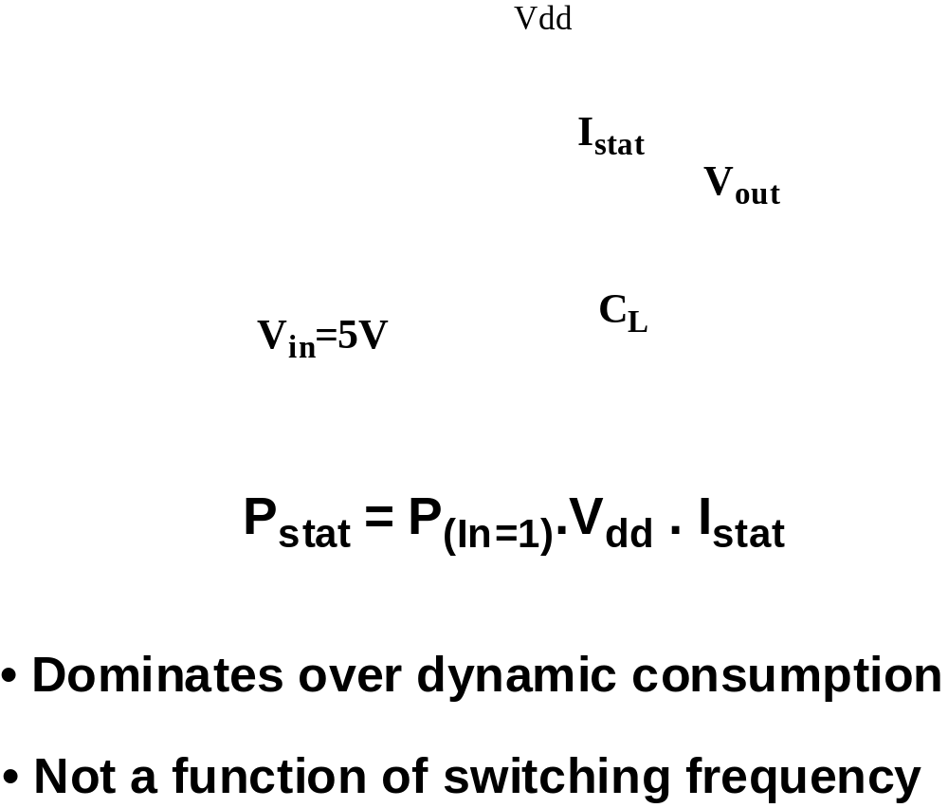
Static Power Consumption
Ideally
static current is zero, but
due to leakage current in the reverse biased diode current is not zero
M.E.Zaghloul

Slide 62
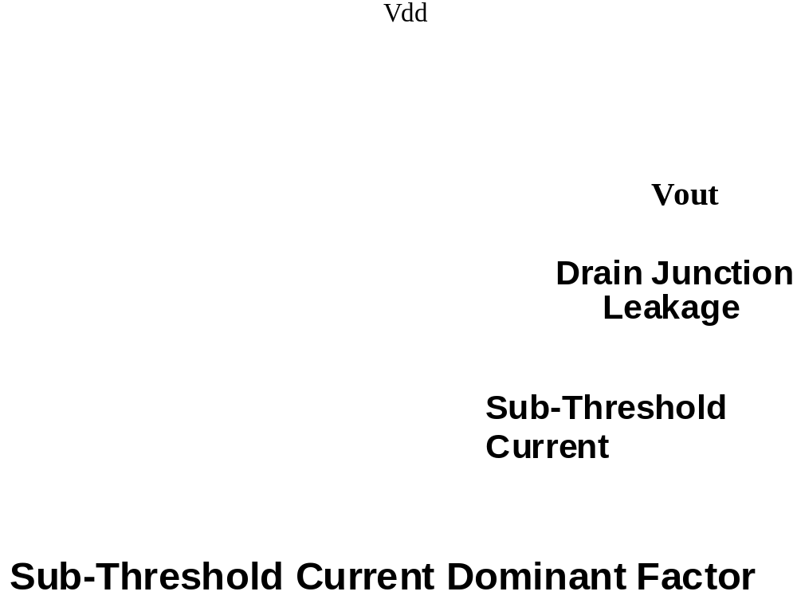
Leakage
M.E.Zaghloul

Slide 63
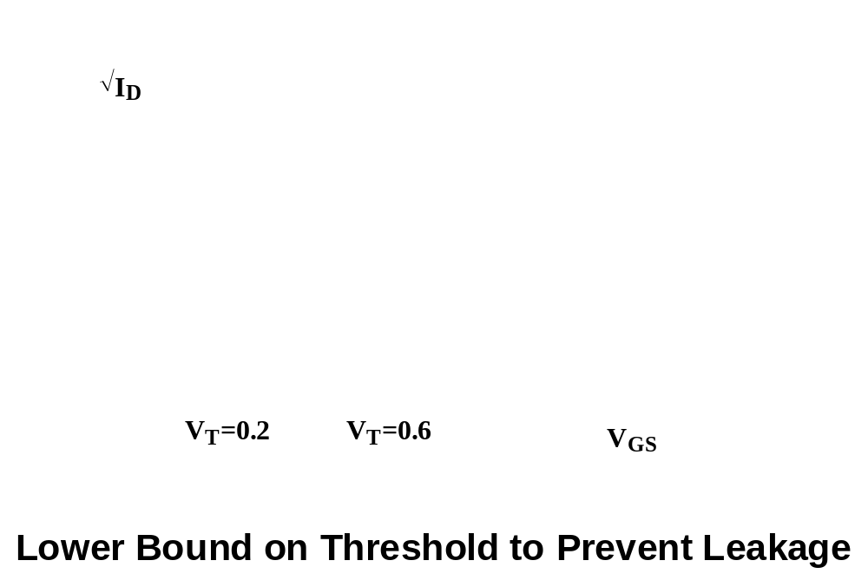
Sub-Threshold current in MOS
Source of leakage
Decreasing Threshold voltage increases the subthreshold current
M.E.Zaghloul

Slide 64
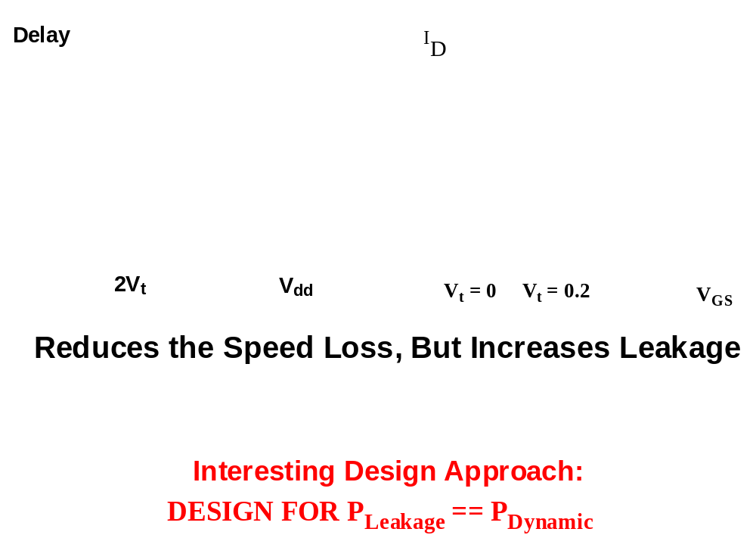
Lowering the Threshold
M.E.Zaghloul

Slide 65
Lowering the Threshold Voltage
Lowering the threshold voltage are bounded by the amount of allowable subthreshold leakages current
This will cause reduced noise margins and the loss of performance
M.E.Zaghloul

Slide 66
Total Power
P(total) = P (dynamic) + P ( direct path) + P(leakage)
Dynamic power is the most significant, the other two can be reduced by careful design
M.E.Zaghloul

Slide 67
Power Delay Product
Quality measure for logic gates
PDP = P_{av} t_{p} ( watt* Second ) = Joule
Assume gate is switched at its maximum possible rate f_{max} = 1/(2t_{p})
PDP = C_{L}V² f_{max} t_{p}
PDP = C_{L}V²/ 2 , represents a measure of energy
M.E.Zaghloul

Slide 68
Low power CMOS Design
The dominant power source in CMOS is the dynamic power consumption
Thus if the frequency is a fixed parameter, the power can be reduced by manipulating the power supply voltage VDD and the effective load capacitance
M.E.Zaghloul

Slide 69
Reducing the supply Voltage
We pay speed penalty for VDD reduction
The power delay product improves as the delay increase
To conserve energy it is desirable to operate at the slowest possible speed
M.E.Zaghloul

Slide 70
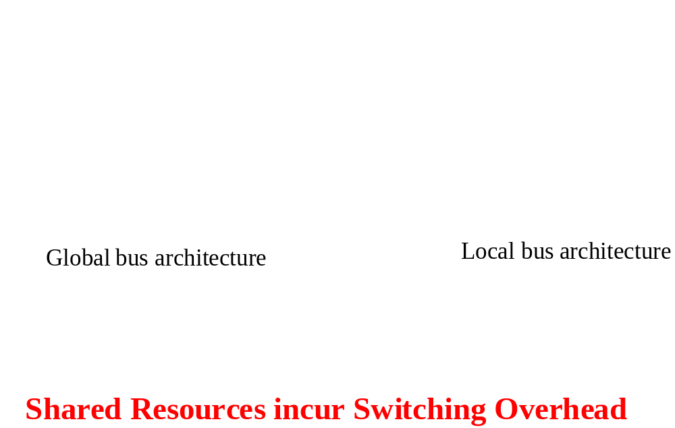
Reducing Effective Capacitance
M.E.Zaghloul

Slide 71
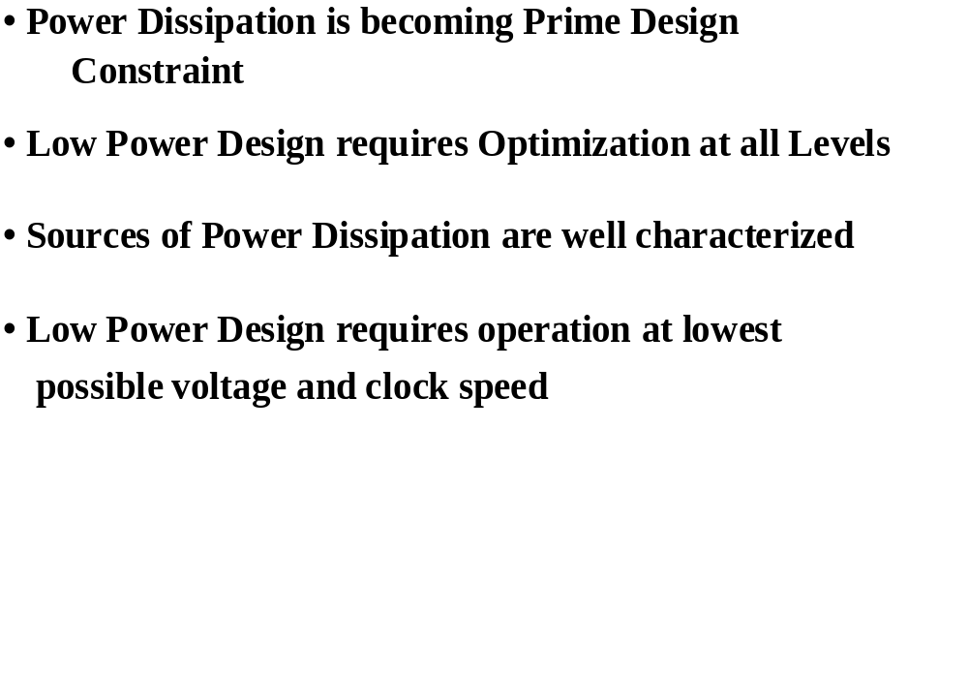
Summary
M.E.Zaghloul

Slide 72
Goals of Technology Scaling
Make things cheaper:
  Want to sell more functions (transistors) per chip for the same money
  Build same products cheaper, sell the same part for less money
  Price of a transistor has to be reduced
But also want to be faster, smaller, lower power
M.E.Zaghloul

Slide 73
Technology Scaling
Goals of scaling the dimensions by 30%:
  Reduce gate delay by 30% (increase operating frequency by 43%)
  Double transistor density
  Reduce energy per transition by 65% (50% power savings @ 43% increase in frequency
Die size used to increase by 14% per generation
Technology generation spans 2-3 years
M.E.Zaghloul

Slide 74
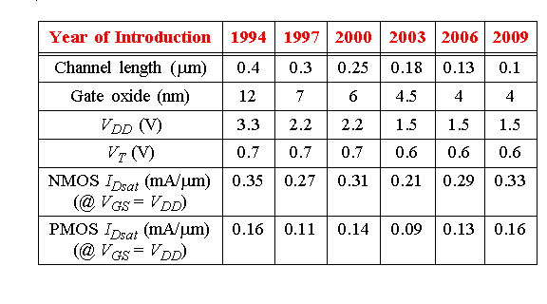
Technology Evolution (1999)
M.E.Zaghloul

Slide 75
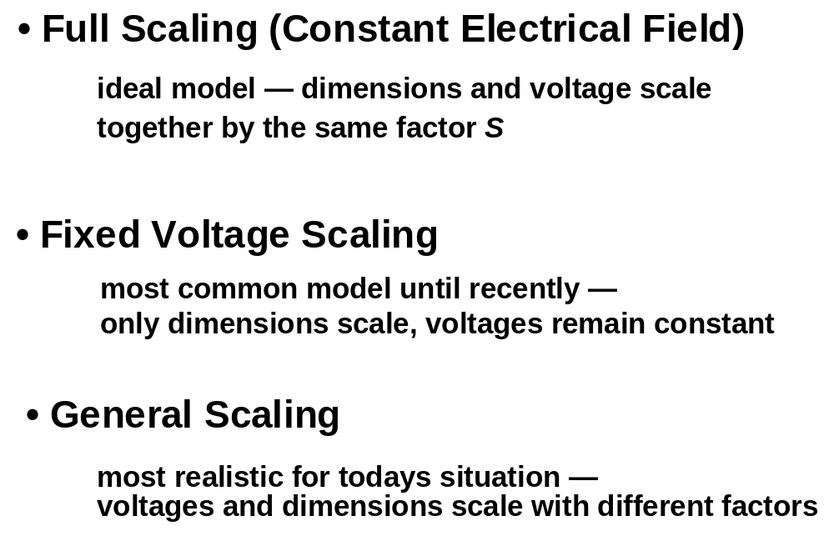
Technology Scaling Models
M.E.Zaghloul

Slide 76
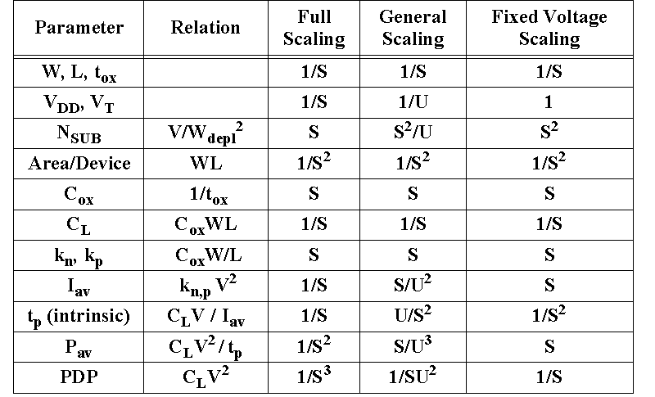
Scaling Relationships for Long Channel Devices
M.E.Zaghloul

Slide 77
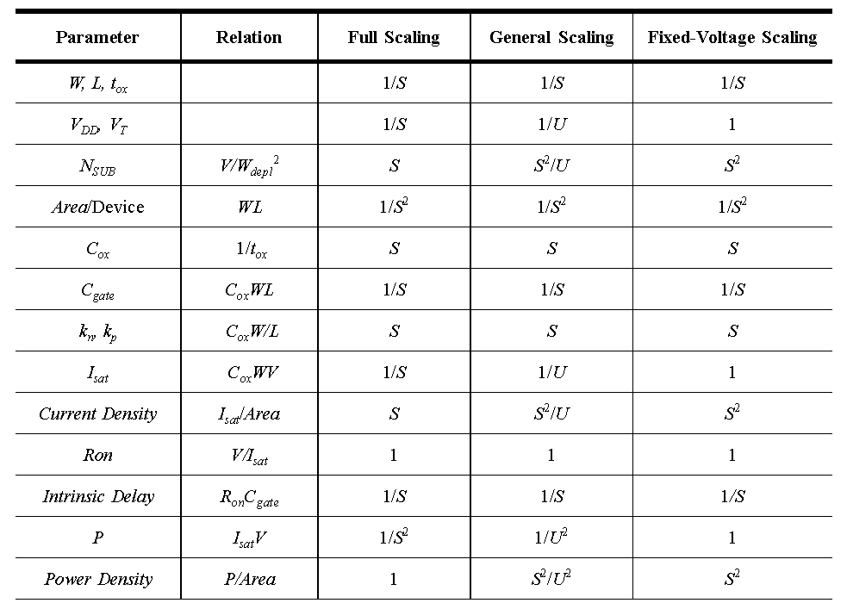
Transistor Scaling
(velocity-saturated devices)
M.E.Zaghloul

Slide 78
Outlook
Performance
  1 TIP (terra instructions/s)
  3-10 GHz clock, multi-core design
Size
  No of transistors: 2 B or more, different type of transistor MG 22nm
  Die: 40*40 mm
Power
  10kW!!
  Leakage: 1/3 active Power
M.E.Zaghloul
P.Gelsinger: μProcessors for the New Millenium, ISSCC 2001

